Slide 1
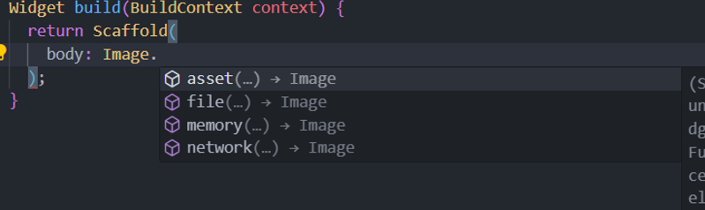
images
Adding an image is pretty simple, to add an image, just type Image., and you will prompted with, 4 types, we will focus on two asset and network

Slide 2
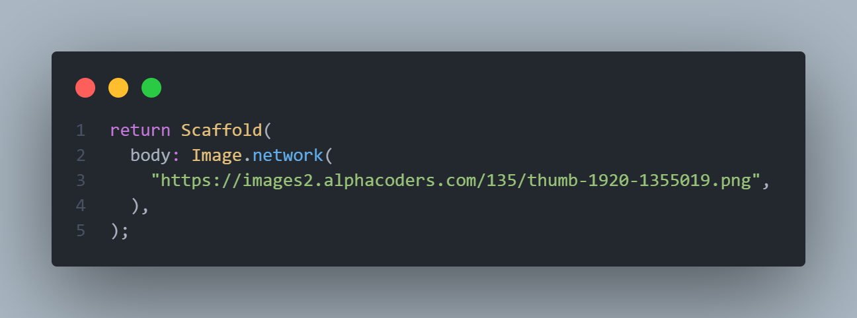
Image.network
Image network just takes a valid URL, and then the image is displayed
https://images2.alphacoders.com/135/thumb-1920-1355019.png
Just copy this URL between the ()

Slide 3

Image.network
Image network just takes a valid URL, and then the image is displayed
You can also give it width and height, but most importantly, you
Can give it a fit, which takes , the default being BoxFit.contain
Sometimes you may set width and height that are not appropriate
For the image, or dosen’t go along with it’s aspect ratio, so the image
May look stretch, in this case you use BoxFit.cover

Slide 4

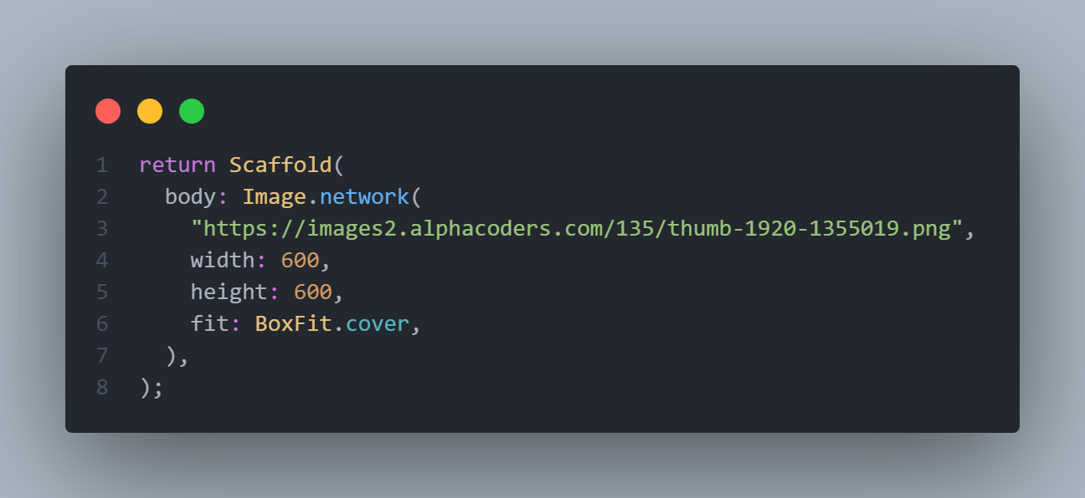
Image.network BoxFit.cover
The image is cropped, but you can see the image is not
stretching

Slide 5

Image.network BoxFit.fill
The whole image is displayed, but the image is somewhat
Stretchy, this is because the aspect ratio is not correct
So it’s better most of the times to set one dimension and
Leave the other one with no value, this let’s the Flutter
Determine the appropriate aspect ratio for the image
There is of course a lot of attributes in the image widget
Feel free to experiment with them but these are the
Important ones

Slide 6
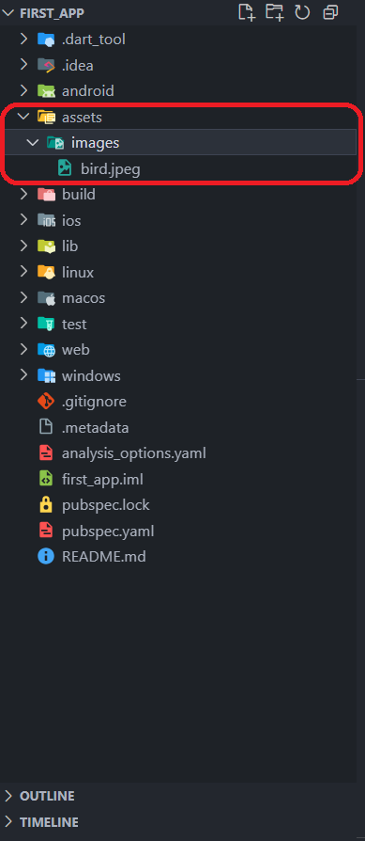
Image.asset
The next way to add an image is through assets, first we will
Create an assets folder, inside we will make another folder with
The name images and then copy any image inside it, in our case
We have an image named bird.jpeg
Next we will go the pubspec.yaml file and add the path of the
Folder in our assets

Slide 7
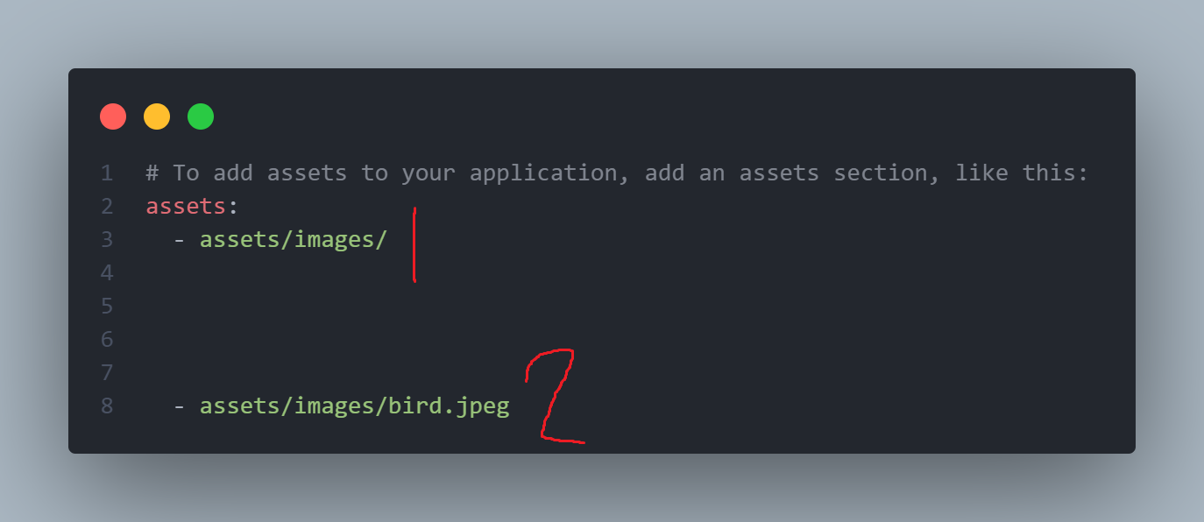
Image.asset
This is the way for adding images in, just scroll down, until you find the assets and then uncomment the code, after that add the path of your assets
In 1 you add the whole folder
In 2 you add that specific image
Mostly we will deal with lots of images, so stick to number 1 of specifying whole folders

Slide 8
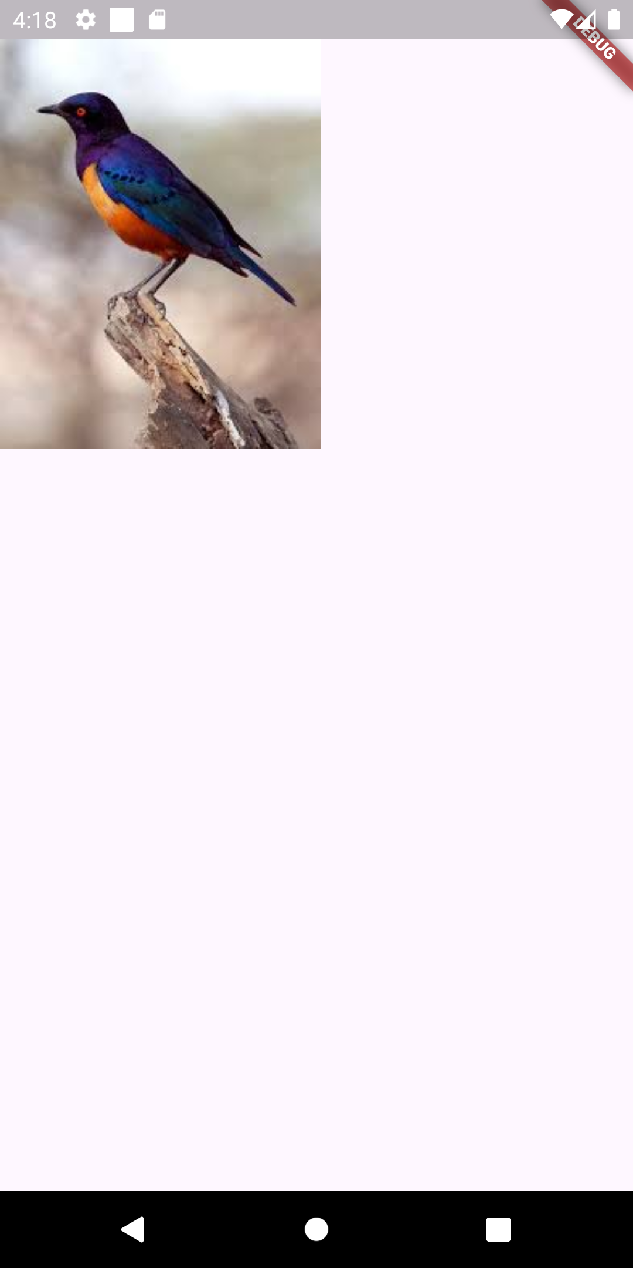
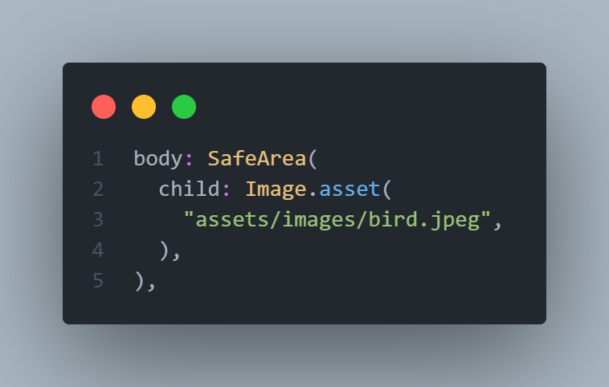
Image.asset
We just replace network with asset and put in the path of the image to see the result, we can also give height, width and fit, so it has the
Same attributes as the Image.network

Slide 9
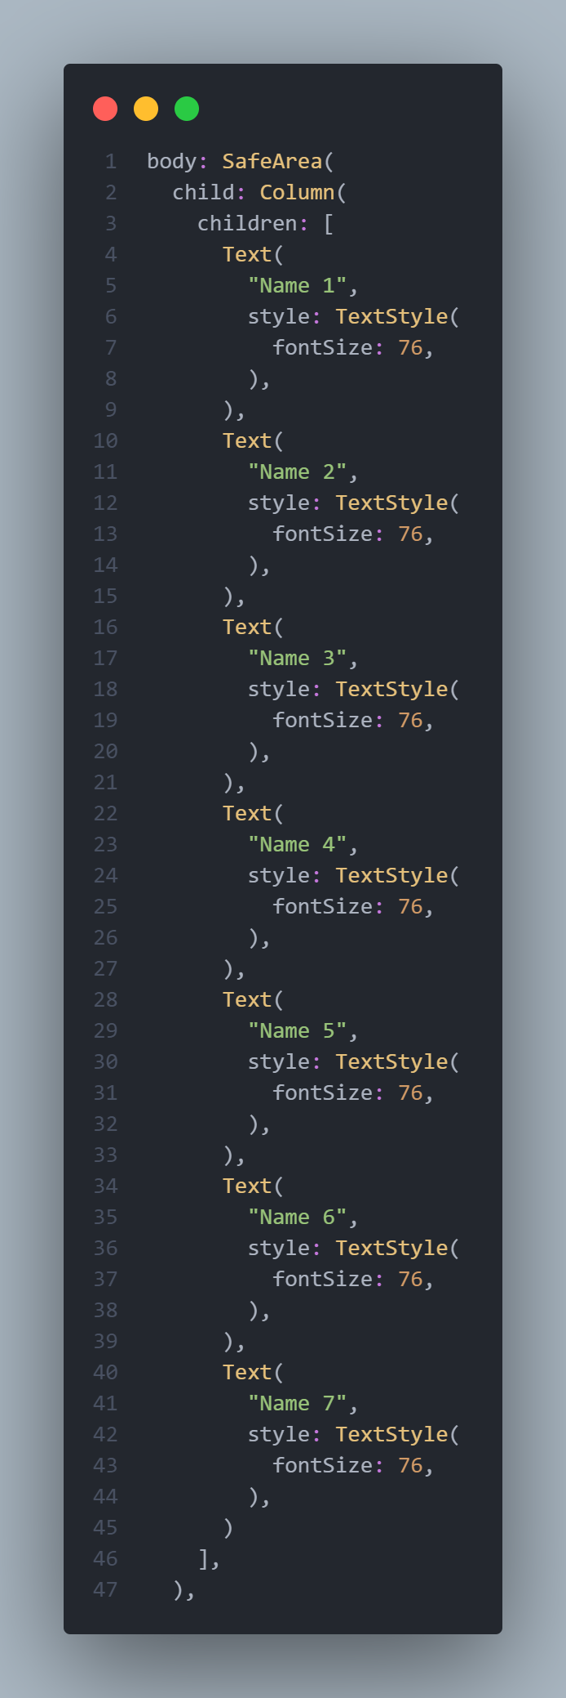
Scrollable list Vertical Scrolling
Ok, just for demonstrations we added a lot of items in
The Column widget, if we open the emulator we see yellow
box, this indicates an overflow, an overflow happens when
A child item dimensions are greater that its parents.
The second reason is the use of Column and Rows, when
We use columns we say that we will give infinite height for
For the column, same thing for the Rows, we say we will
Give infinite width for that row, and if you try to scroll you
Will not able to, that’s why you should tell Flutter explicitly
That list is scrollable,by using SingleChildScrollView

Slide 10
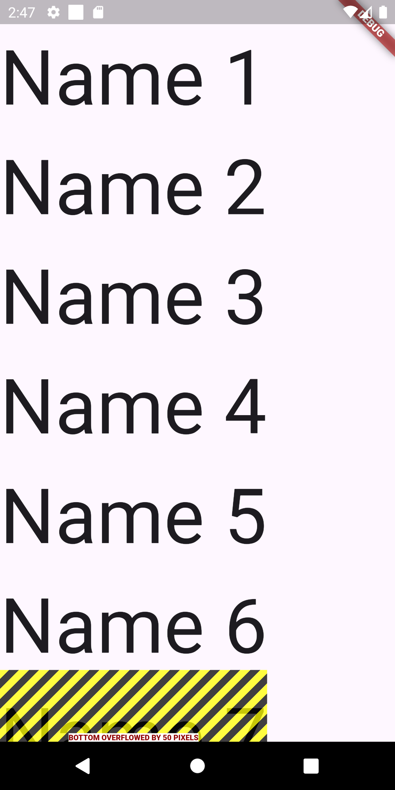
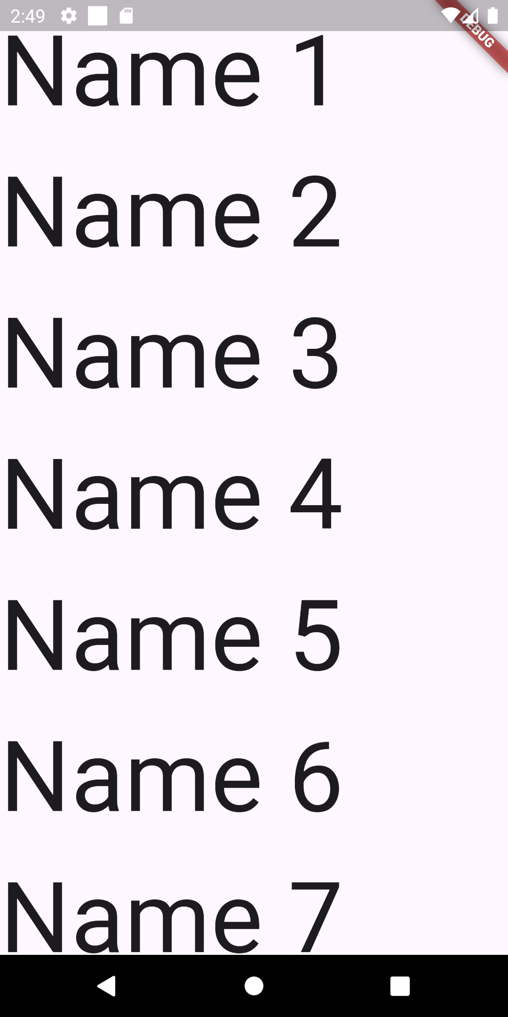
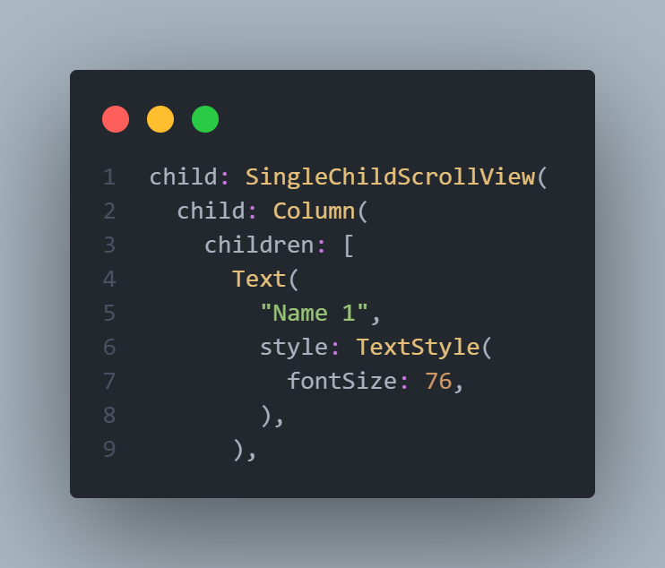
Scrollable list Vertical Scrolling
The image on the left is before wrapping
The widget with SingleChildScrollView and the
Image on the right is after

Slide 11
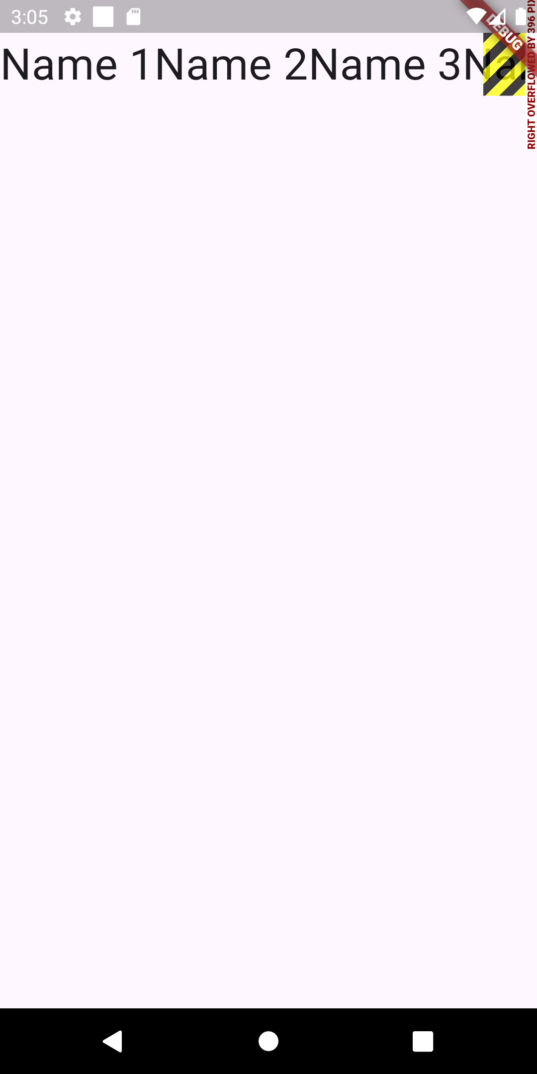
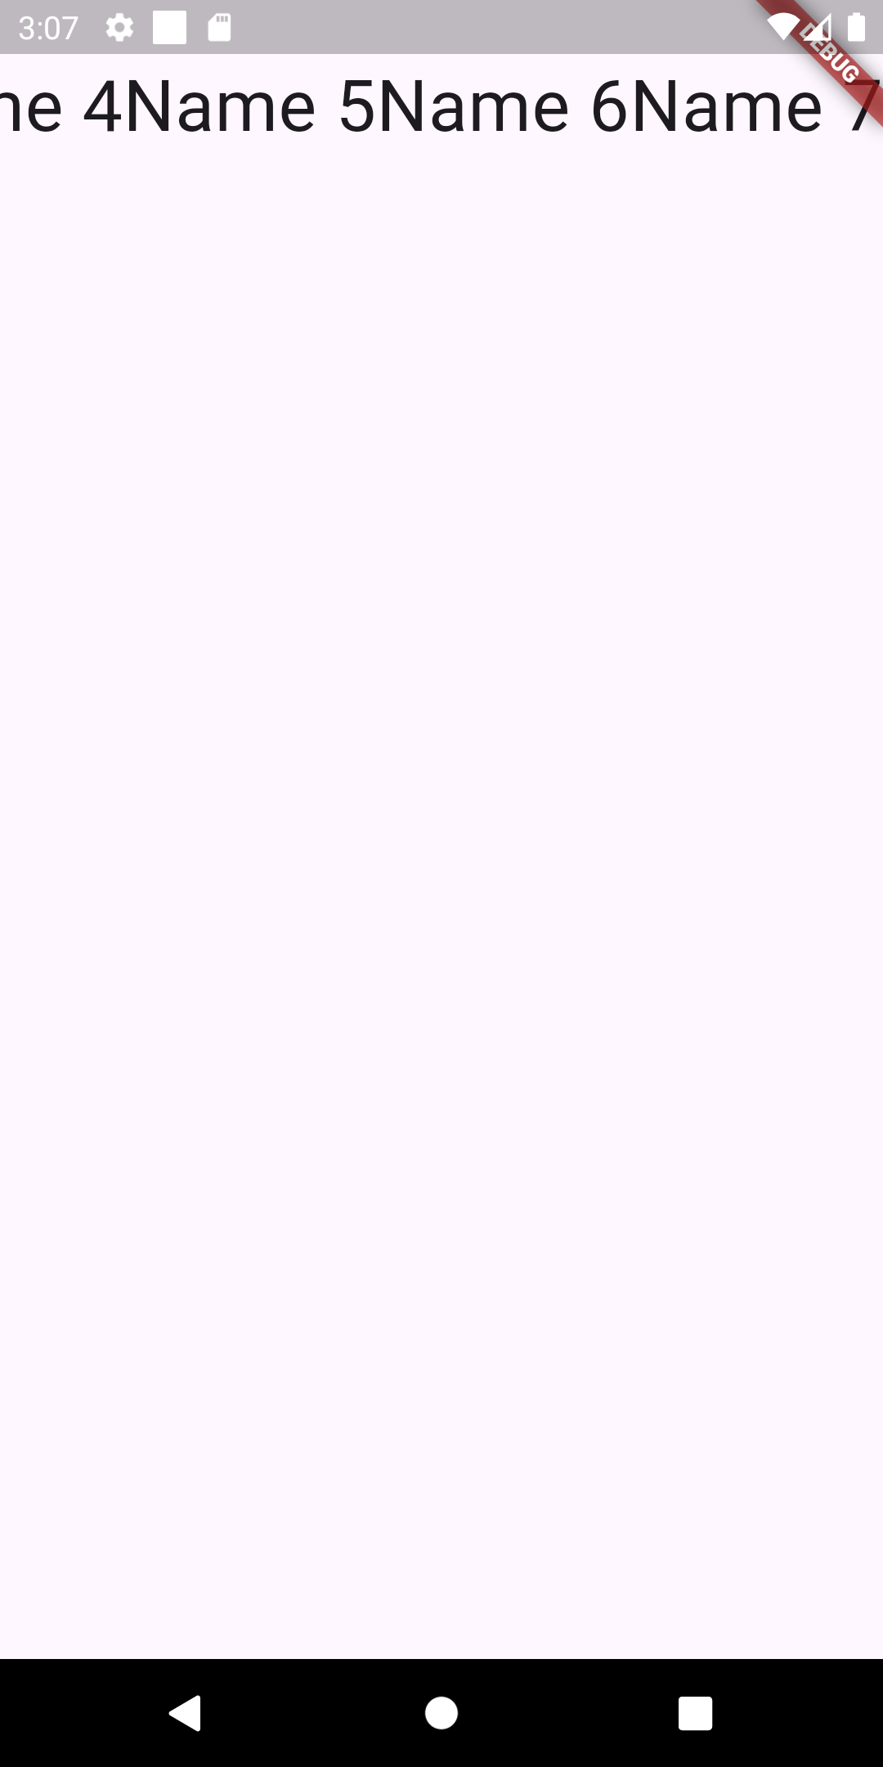
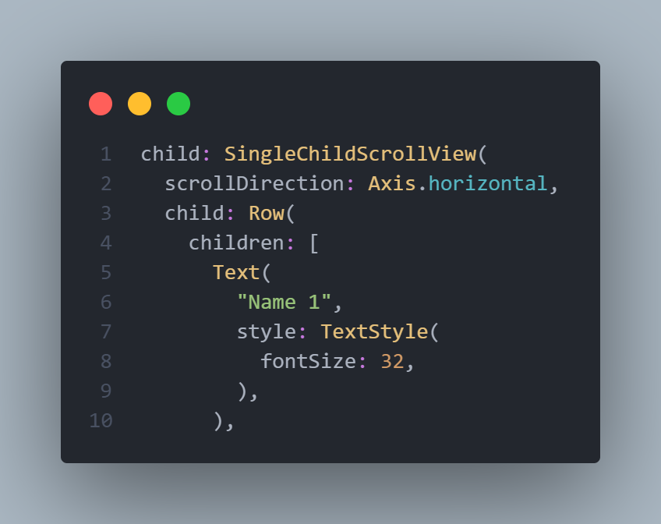
Scrollable list Horizontal Scrolling
Same thing would happen if we replaced
The Column with a Row widget, if we wrap it
with SingleChildScrollView, it’s not enough we
must tell it that the scrolling is Horiziontal

Slide 12
Spacing using Expanded
Sometimes you may want an item or more to take the available or remaining space inside a Row or a Column, say you have a phone of 600 pixel in height, and you have two items inside a Column and you want the two of them to take half the height, you could simply give each one 300 pixel, but if we tried the same layout on another phone with 700 pixel you will be left with 100 pixel and so on, so to calculate the dimension automatically you can use the Expanded widget, inside or a row or a Column, if you use it inside a Column it will calculate the height, if you use it in the Row you will calculate the width
NOTE : Expanded widget can be used inside Column and Row only

Slide 13
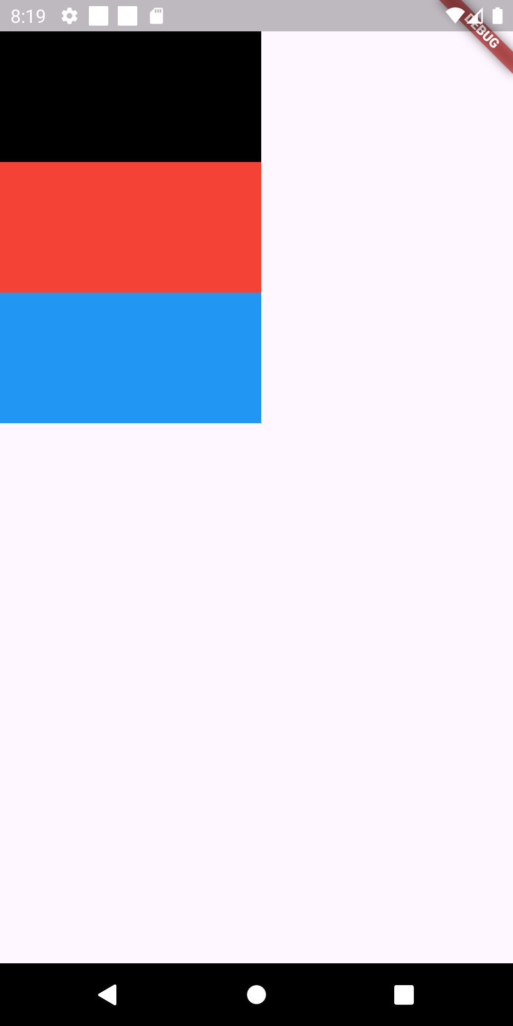
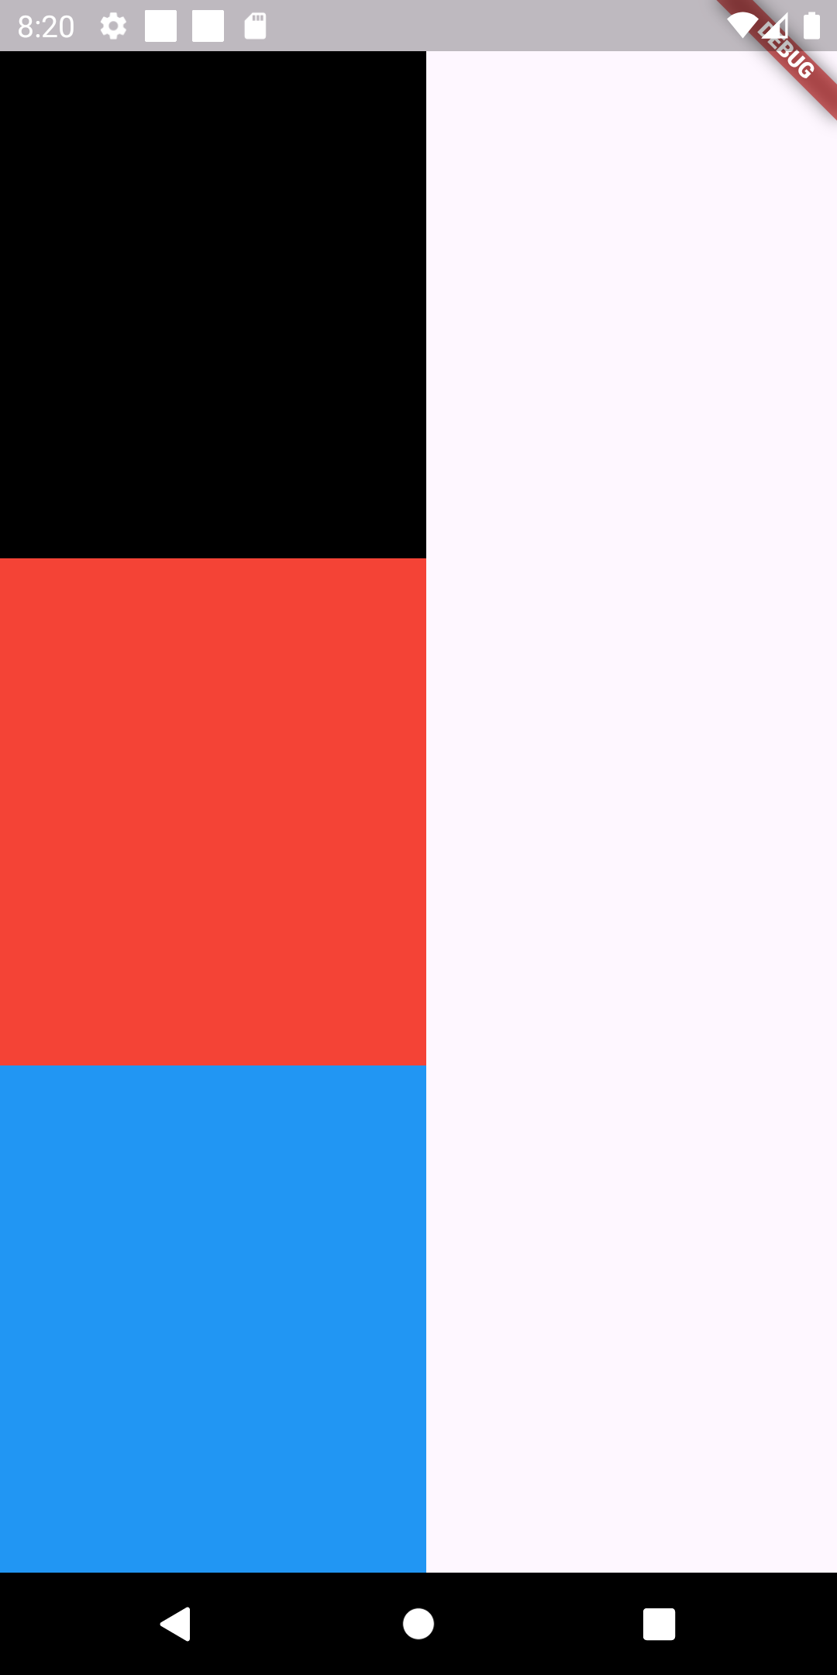
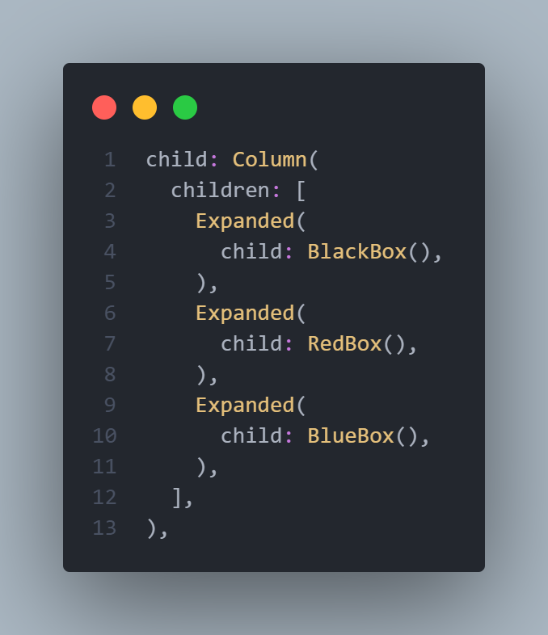
Spacing using Expanded
We have three boxes if 200 in width and 100 in height, before using the expanded, once we use the expanded the height
Is overridden and all 3 become equals
If you want to make one of
The boxes height larger
than the others you can
Use the flex attribute inside
Expanded
The default is 1

Slide 14
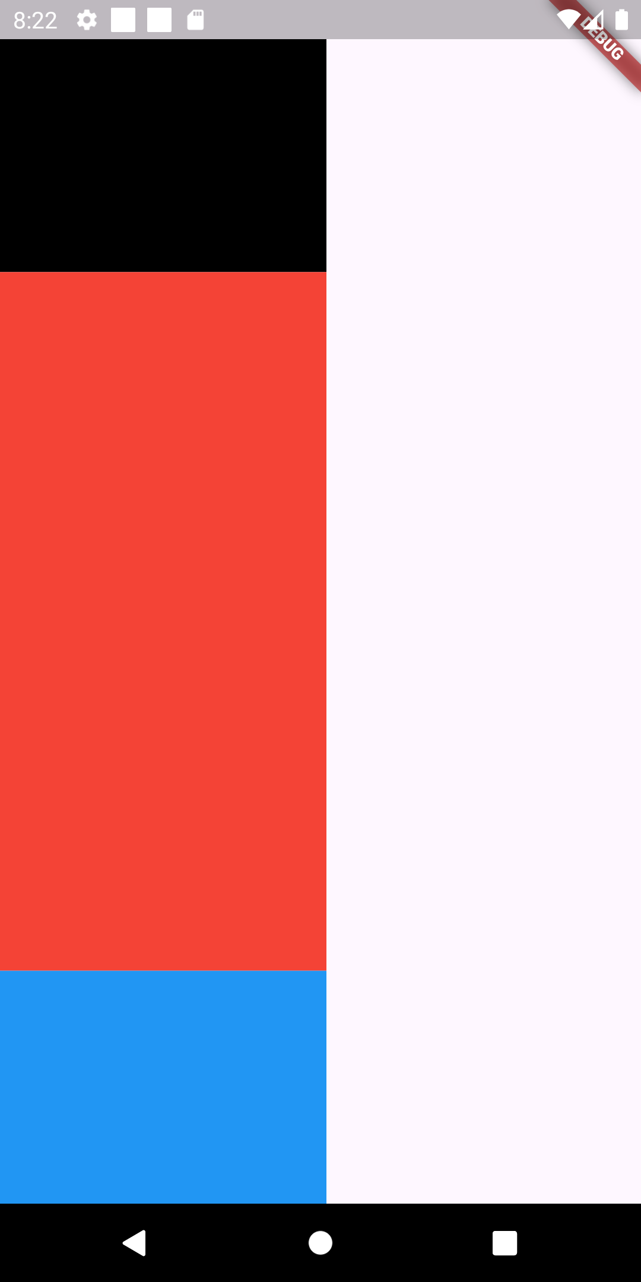
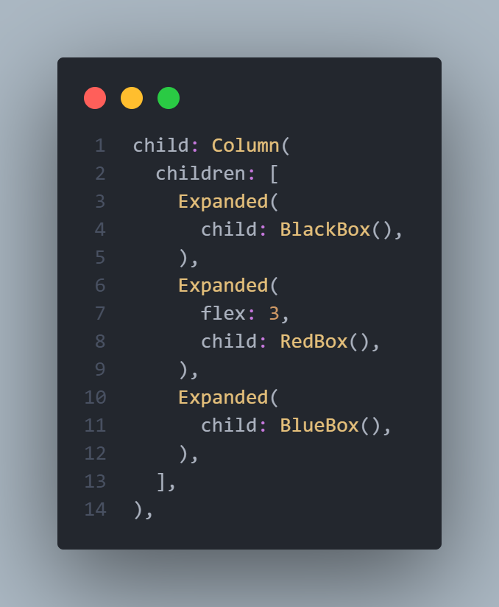
Spacing using Expanded
We simply have 3 items, the first two have a flex of 1, and the second one have a flex of 3, so the total flexes are 1 + 3 + 1 = 5
So the first and the last one takes 1 / 5 of the screen, while the
Second one have 3 / 5 = of the screen
So you can think of the expanded as a screen
Divider, if divided the space of the screen
Among the three items,
Same thing goes when using expanded inside a row
But it will divide the width not the height

Slide 15
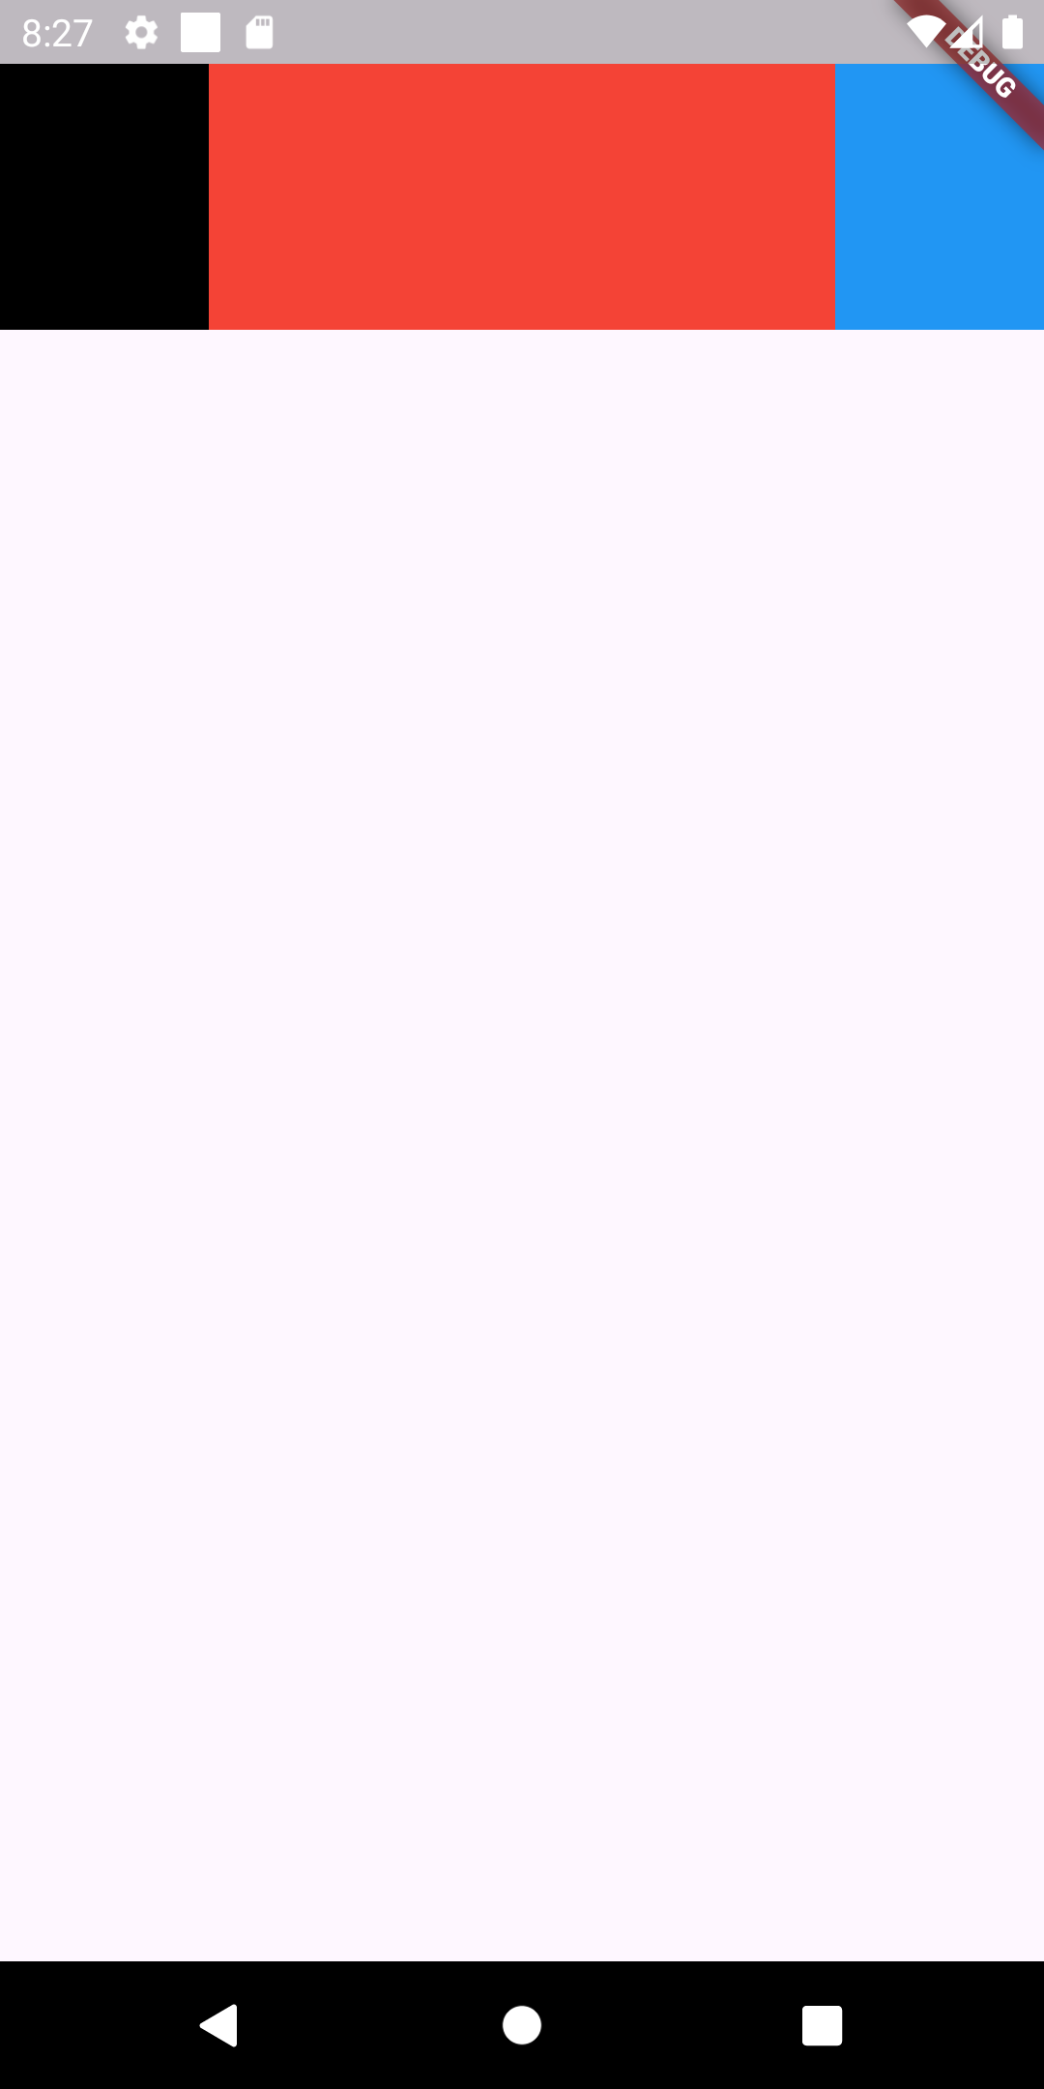
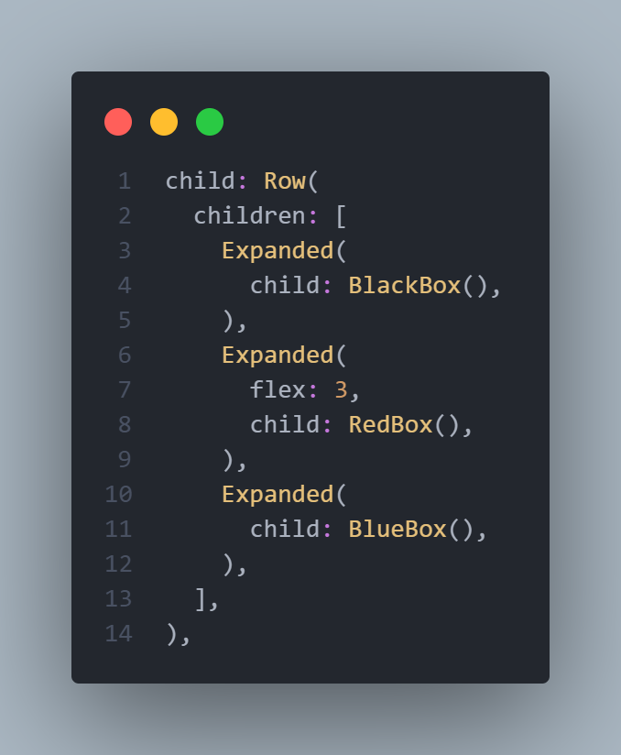
Spacing using Expanded
Same thing goes for the Row, now it divides the width among the 3 items and does the same calculation
NOTE: EXPANDED CAN BE USED INSIDE COLUMN OR ROW ONLY
NOTE : YOU CAN”T USE EXPANDED INSIDE OF
COLUMN WITH SINGELCHILDSCROLL VIEW

Slide 16
Efficient scrolling using Listview.builder
In real world scenarios, you will be asked to display tens and hundreds of real world data coming from a server, the problem with using SingleChildScroll view inside a column, is that it builds all the items even if you don’t scroll to view them, to fix this issue we use the ListView.builder to efficiently build scrollable items.
We will assume having a list of 15 names that are coming from the backend and we will try to display them

Slide 17
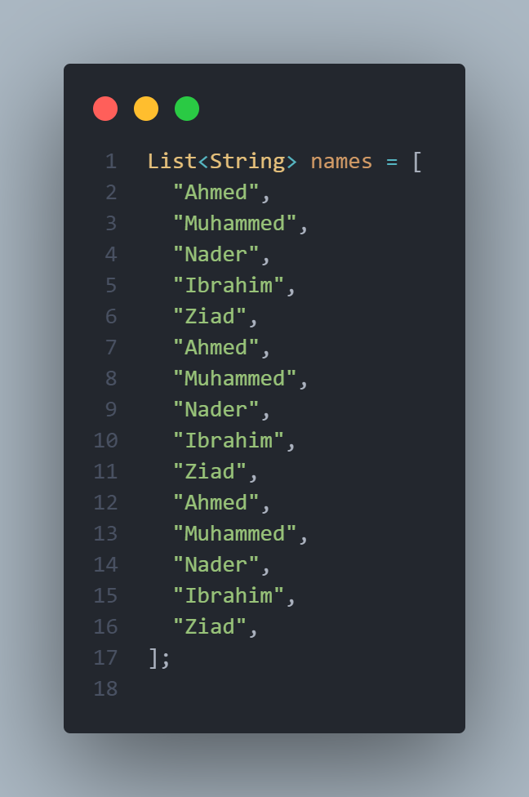
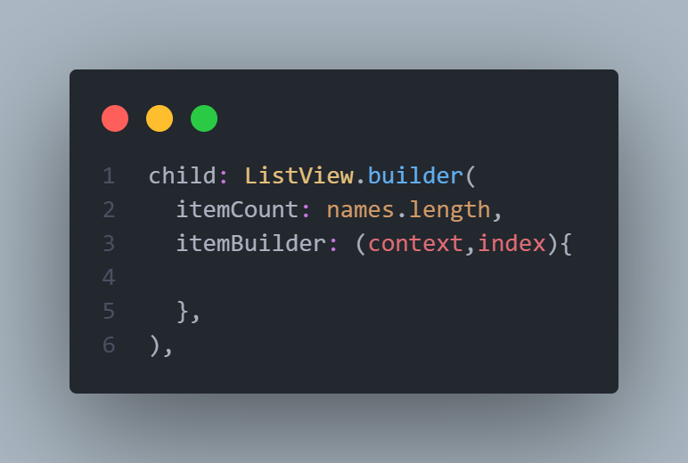
Efficient scrolling using Listview.builder
itemCount takes the an integer which is the length of the list we want to display, and the itemBuilder maybe stranger, but if we hover it we see that it accepts a function and returns a Widget, this function takes a BuildContext and an integer which refers to the index of items in the list
Context or the BuildContext is a little advanced topic but
Simply think of it as a way
Telling flutter where each
Widget is in the widget tree
To be able to easily access
them

Slide 18
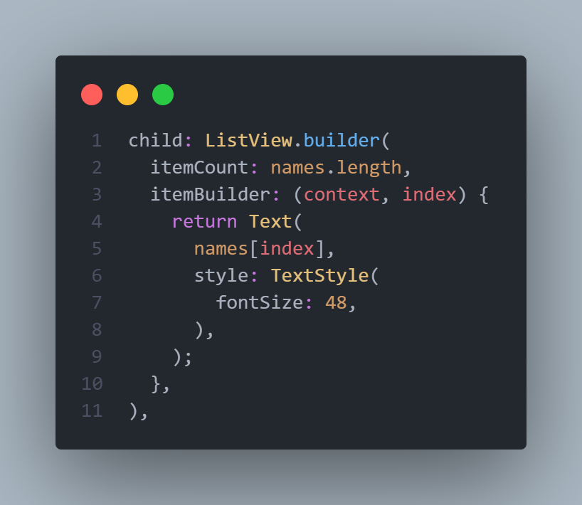
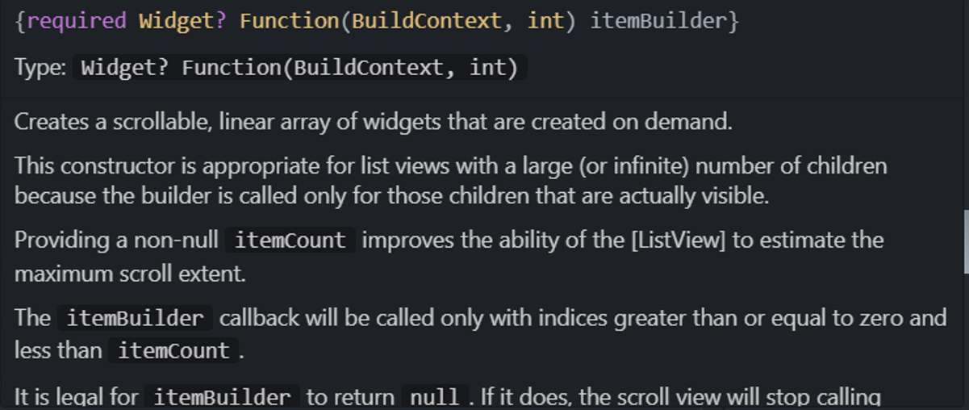
Efficient scrolling using Listview.builder
If we hover over the itemBuilder attribute we see that it is a function that has two parameters one is the BuildContext and the other is an integer which refers to the index of the item in the list, so the names[index] refers to each individual item in the ListView.builder

Slide 19
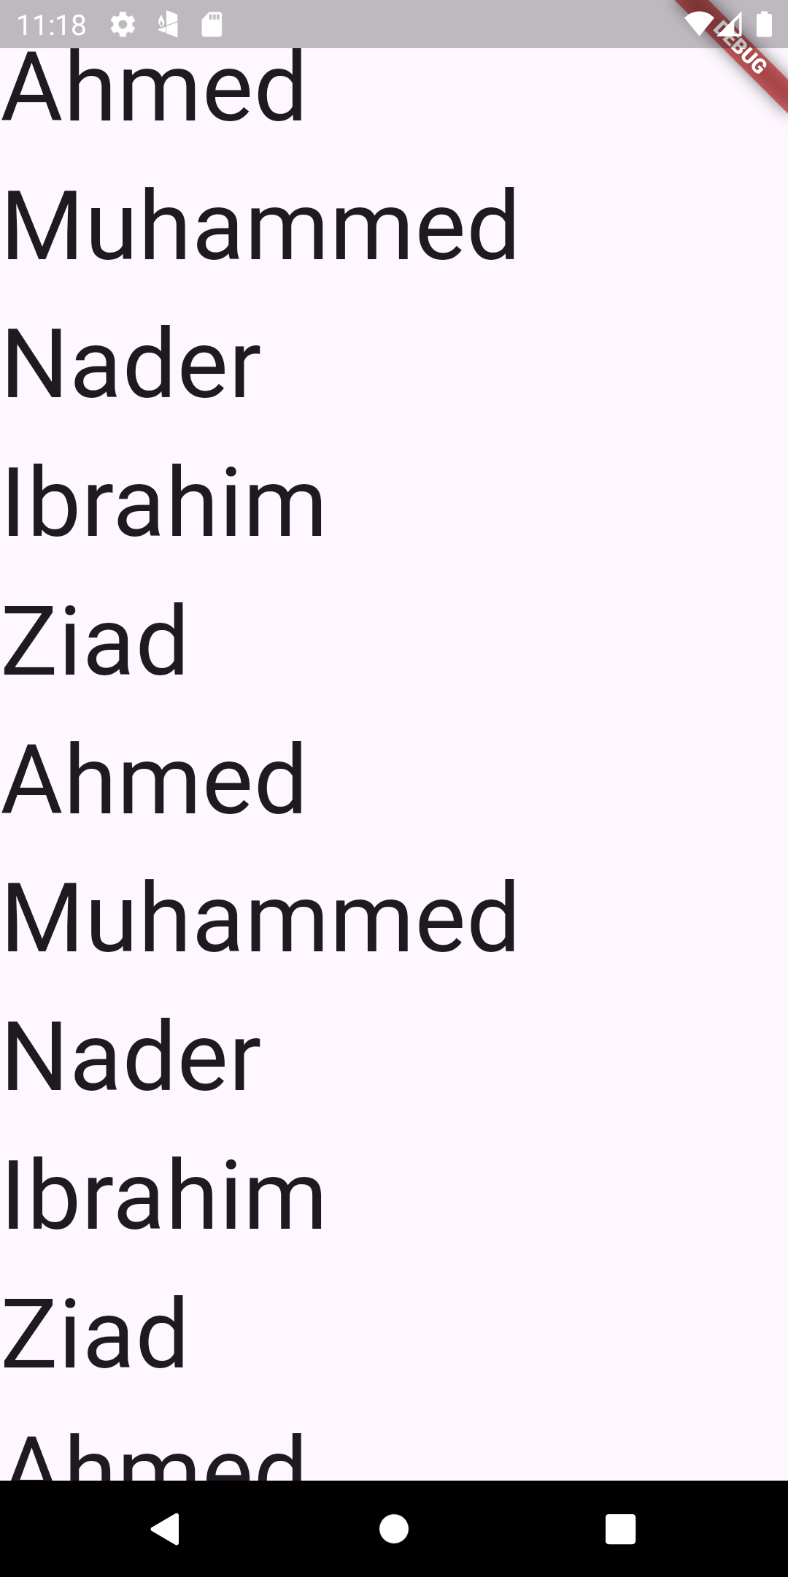
Efficient scrolling using Listview.builder
This is the output of the ListView.builder, we see that each
Individual item is displayed onto the screen

Slide 20
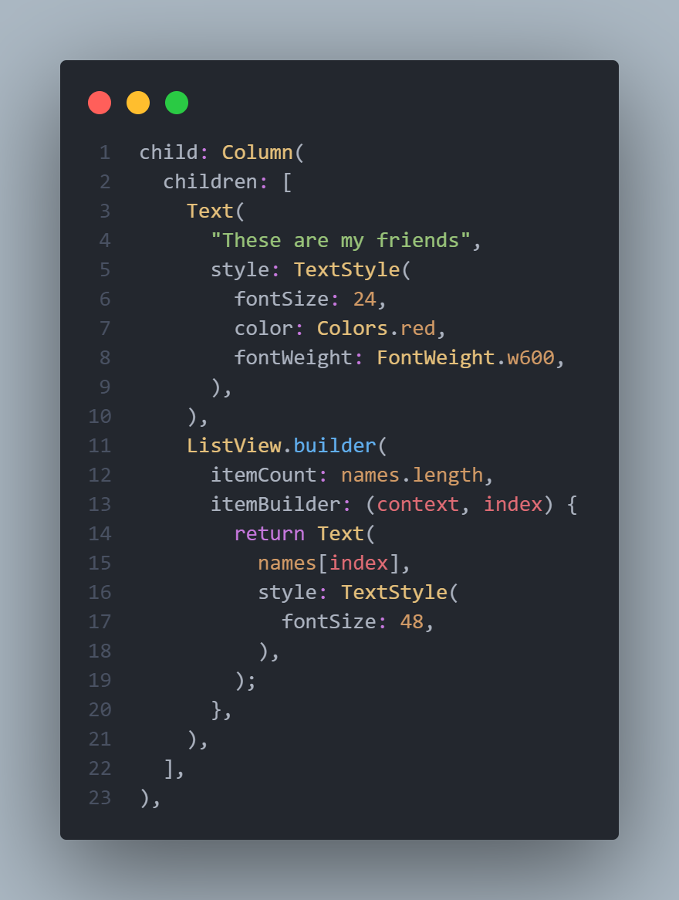
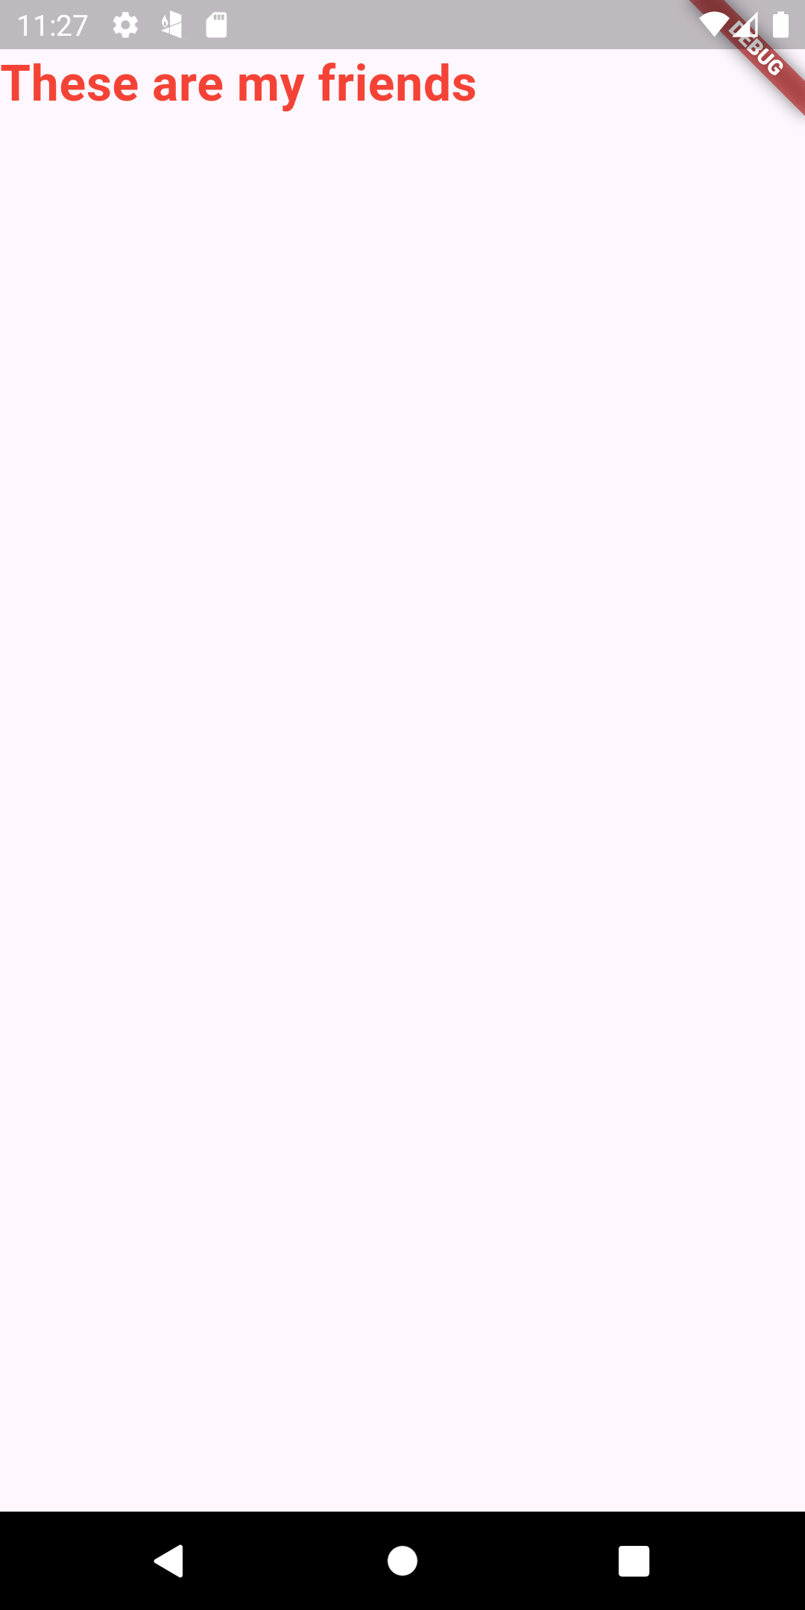
ListView inside a Column
Let’s display a text above the list of names, saying these are my friends, for that we will need a Column with two items, the first being the hardcoded text, and the second one being the dynamic list we but if
We go back to the emulator, we see that only the red text
appears onto the screen and the console throws
an error saying Vertical viewport was given
unbounded height

Slide 21
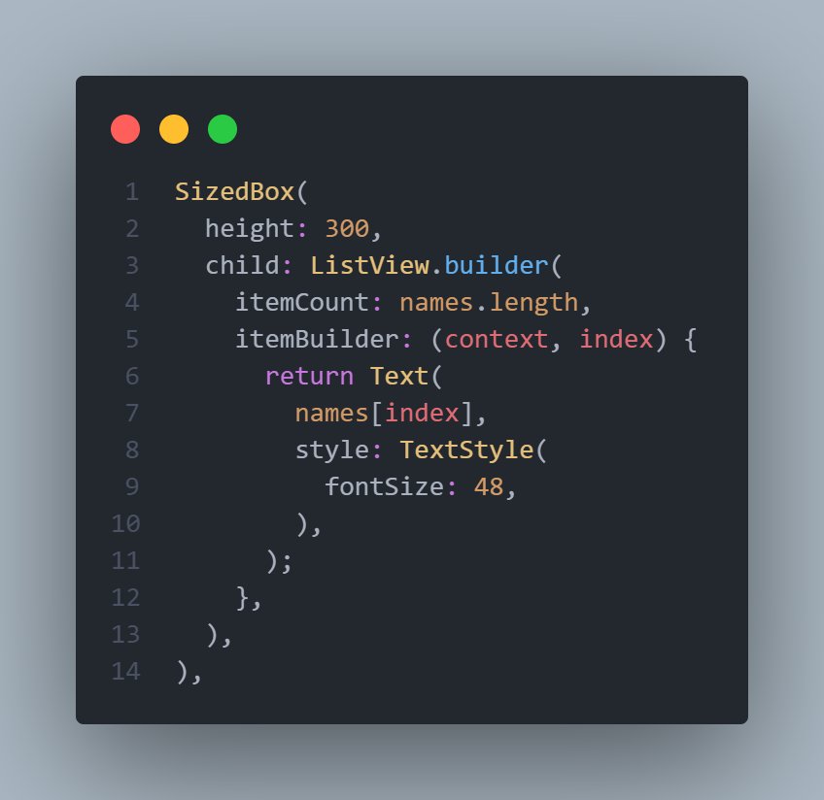
ListView inside a Column
The reason is how the Column and the ListView behaves, Column typically give infinite height to its children so it dosen’t constrain its children while the ListView needs to know how much space it needs to display, but since it’s inside a Column it isn’t constrained, that is why we are seeing that our height is unbounded, so by simply giving a fixed height for the ListView we fix this error, but the out put as you will see in the next slide is
Not very desirable, se we can wrap it with the Expanded
to give it the remaining height of the screen

Slide 22
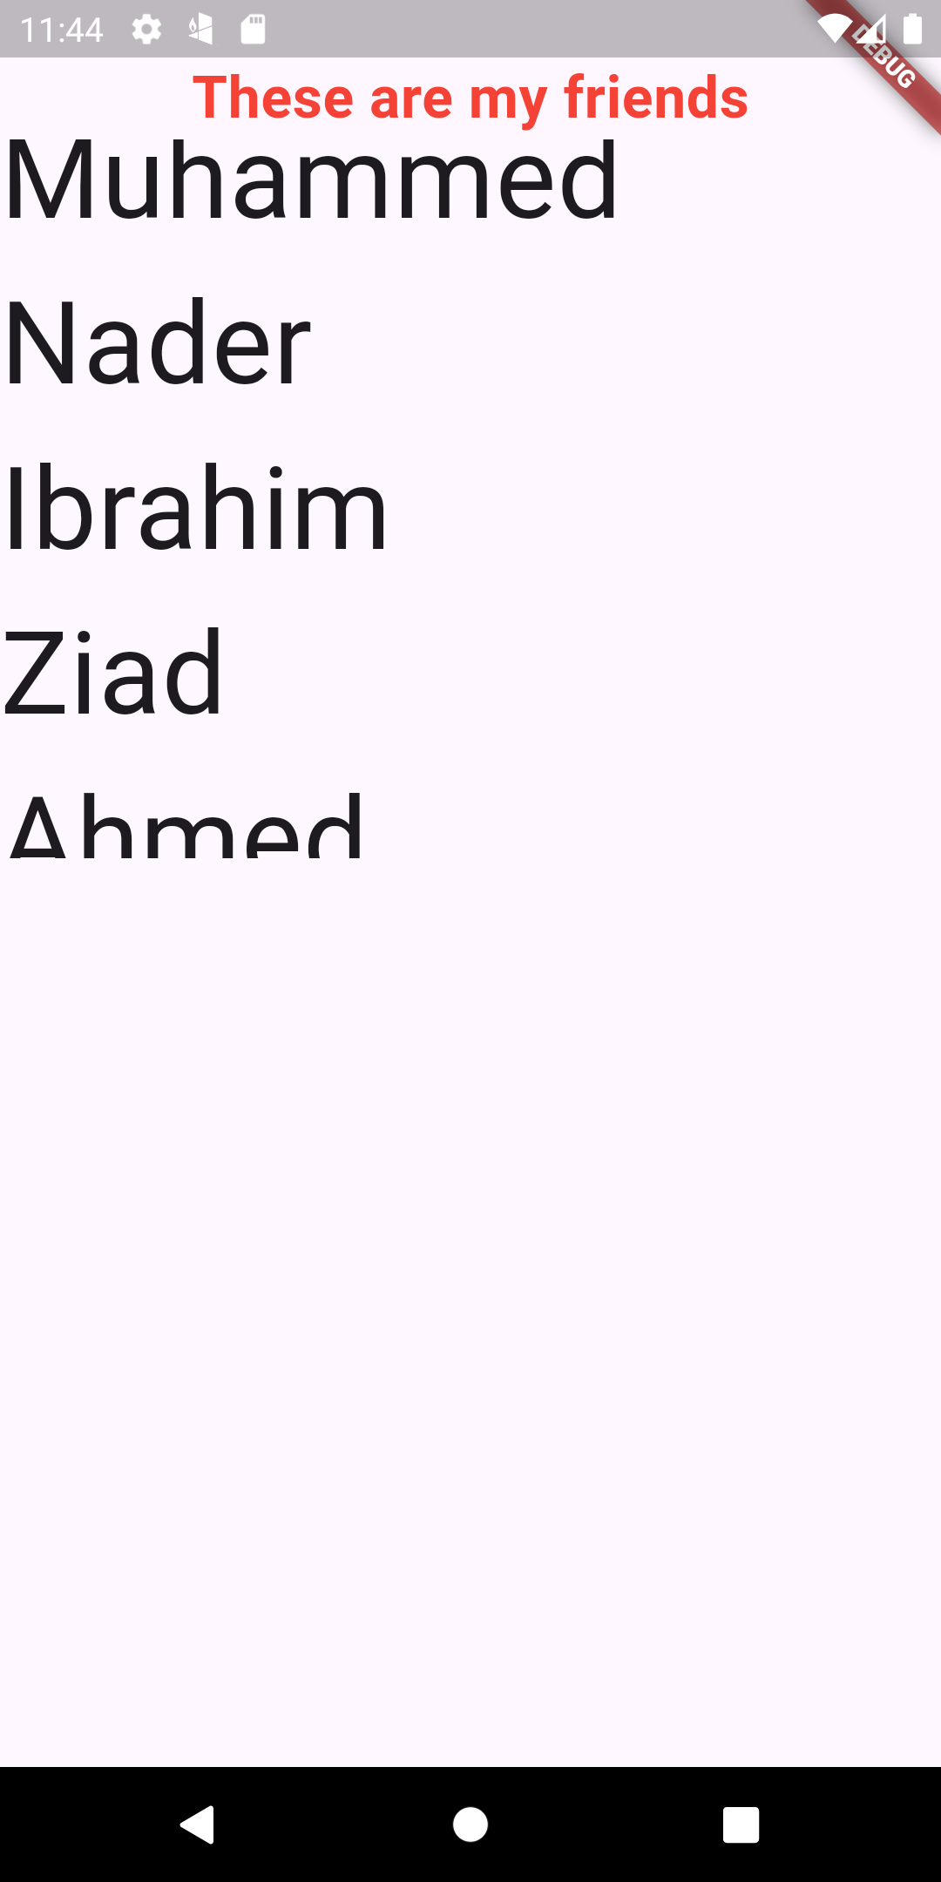
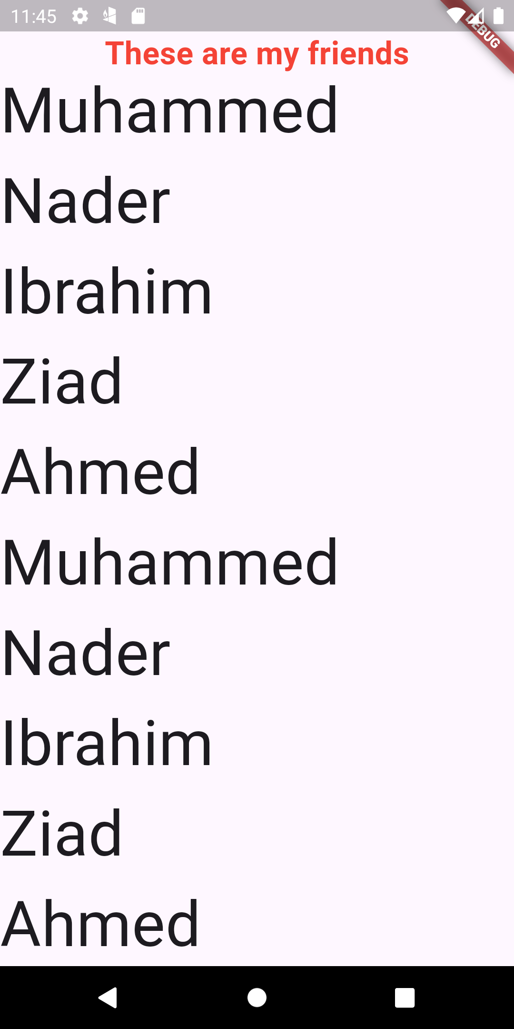
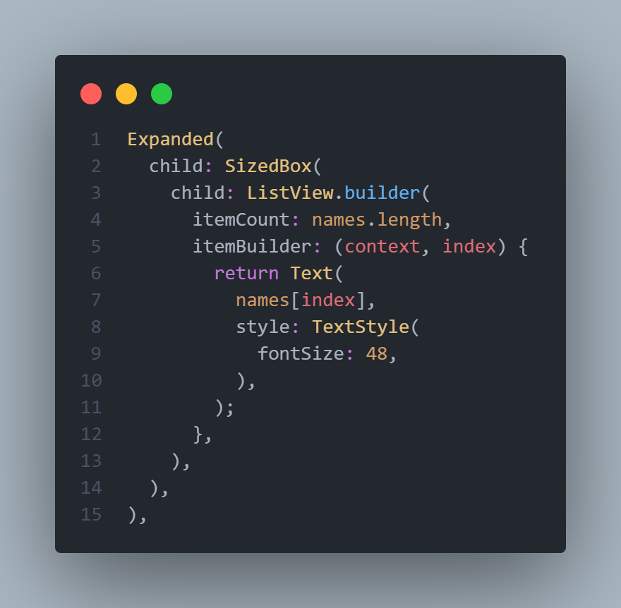
ListView inside a Column
We see that the both UI, one using a fixed height of 300 on the right, the other using the Expanded widget to take the
Full height of the screen

Slide 23
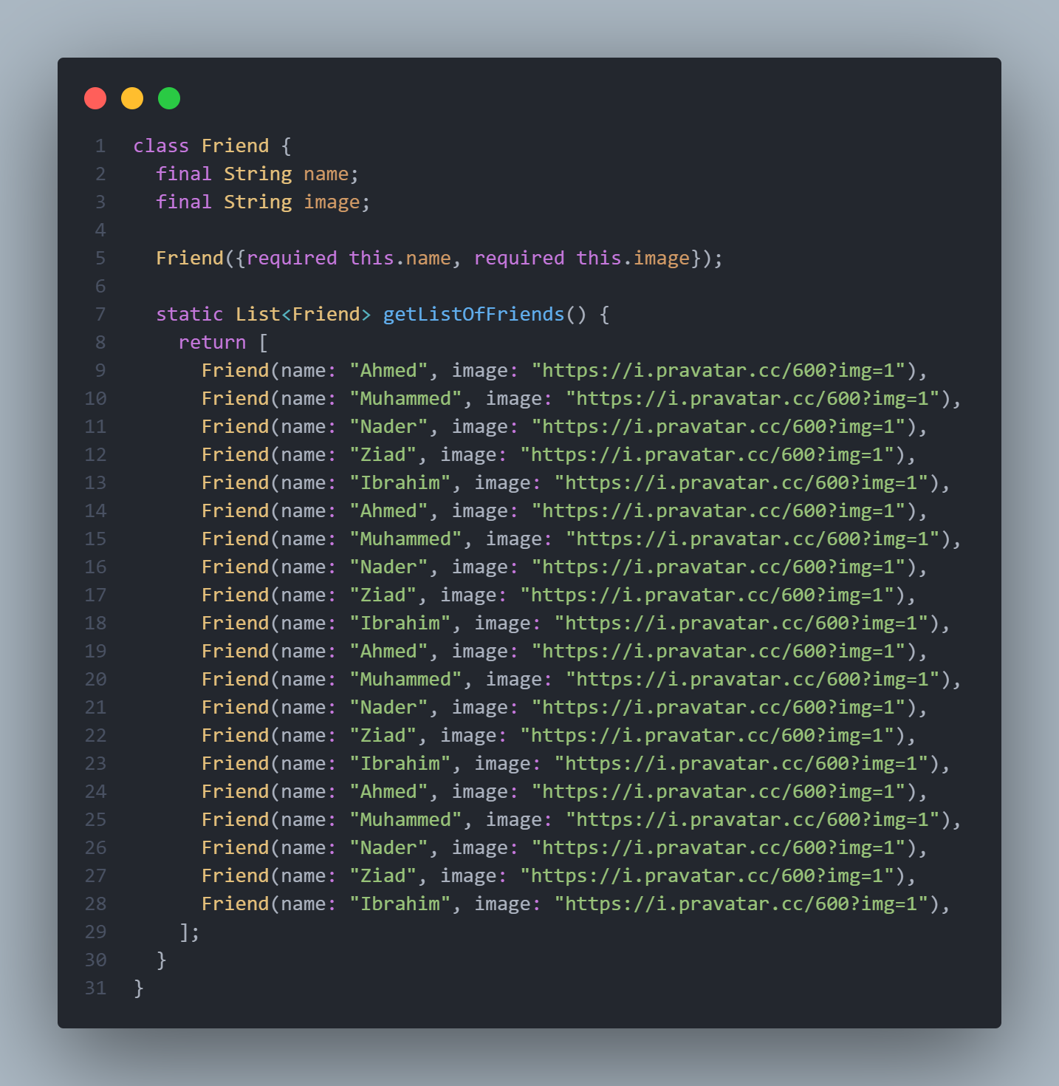
GridView
Sometimes we may want to display items
As a grid, meaning displaying items as a
2-way column or 3-way column or even more
To just simulate real world apps, we will
Create a friend class that has two attributes
As the image shows, then we will create a
Static function that returns a List and we will
Just fixate a dummy image for now

Slide 24
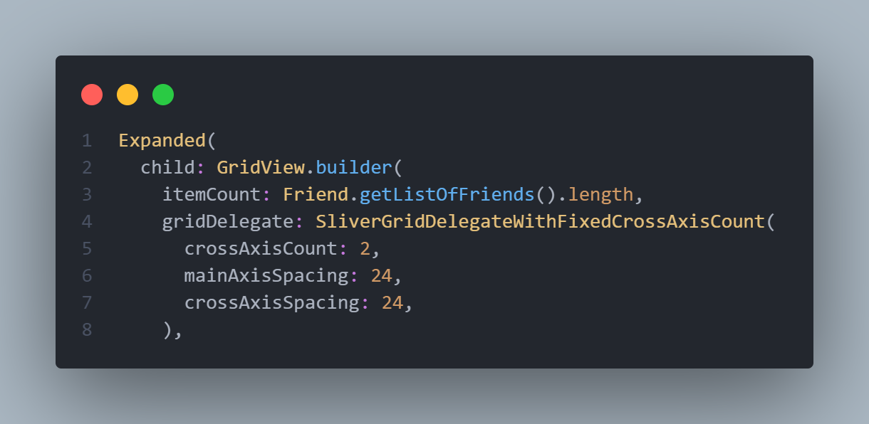
GridView
In the UI we will display the Grid using GridView.builder, which has the same attributes as the ListView.builder except it has one very important attribute called the gridDelegate, which takes very long class called, SliverGridDelegateWithFixedCrossAxisCount just like the image
the most important one being the crossAxisCount which refers to how many columns you wanna have in the grid, the second is the others are for the spacing between each items both
Vertically and horizontally, the fourth
Is childAspectRatio, which is responsible
For the dimensions of the child in terms
Of width / height, if we give it a 2 this
Means that the width is two times the
Height of the child element

Slide 25

GridView
Ok the UI maybe a little complex, don’t worry I will provide
You with the code, but please try to read it and experiment
With different values, ask yourself why did I use the expanded
For the network image and not a fixed height and so on

Slide 26
